Slide 1

A SEMINAR ON
PRODRUG CONCEPT
Presenter : VISHNU SRAVAN.B
M.pharmacy pharmacology IInd semester
SRR College of Pharmaceutical Sciences

Slide 2
Overview
Introduction
Prodrug design
Applications
Conclusion
Reference

Slide 3
Introduction
What is a Prodrug ?
Why Prodrug design ?
Pharmacologically inactive compound which is metabolized to the active drug by either a chemical are enzymatic process.
To decrease unpredictable interactions
To increase therapeutic efficacy
To decrease undesirable toxicity.

Slide 4
Prodrug design
Barrier To drug’s usefulness
Drug
Drug
Barrier To drug’s usefulness
Chemical Modification
Drug
Pro
Pro
Drug
Biotransformation
Drug
Excretion

Slide 5
Barrier To drug’s
Drug
Pharmaceutical phase
Pharmacokinetic phase
Manufacture
Dosage form
Release
Drug in sol. at admin site
Elimination
Absorption
Drug in various body compartments
Distribution
Drug in blood
Elimination
Transport
Pharmacodynamic phase
Elimination
Drug in target organ

Slide 6
Rational Prodrug design
Identification of drug delivery problem.
Identification of physicochemical properties required for maximum efficacy or delivery.
Selection of transport moiety providing a Prodrug derivative exhibiting the proper physicochemical characteristic's and which can be cleaved in the desired biological compartment.

Slide 7
Factors to be considered for designing
Prodrug
Purpose
Expected properties
Site of transformation
Mechanism of transformation
Chemical half life
Solubility

Slide 8
Prodrug linkage and Enzymes involved in hydrolyzing the link
Prodrug Linkage | Hydrolyzing Enzyme
1. Ester
Short medium chain | Cholinesterase
Aliphatic | Ester hydrolase , Lipase , Cholesterol Esterase, Acetyl cholinesterase , Aldehyde oxidase, Carboxypeptidase
2. Long chain aliphatic carbonate | Pancreatic lipase,Pancreatin,Lipase, Carboxypeptidase, Cholinesterase
3. Phosphate, Organic | Acid phosphatase, Alkaline Phosphatase
4. Sulfate, organic | Steroid sulfatase
Conti..

Slide 9
Prodrug Linkage | Hydrolyzing Enzyme
5. Amide | Amidase
6. Amino acid | Proteolytic enzymes, Trypsin, Carboxypeptidase A and B,
7. Azo | Azo reductase
8. Carbamate | Carbamidase
9. Phosphamide | Phosphoramidases
10. β-Glucuronide | β-Glucuronidase

Slide 10
Applications
Towards pharmaceutical problems
Towards pharmacological problems
Site specific drug delivery
Sustaining drug action

Slide 11
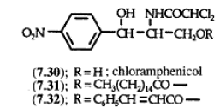
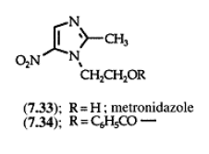
I. Towards pharmaceutical problems
1.Patient acceptability :
a.
Has bitter taste
Unsuitable for suspension preparation
Taste less /inactive cinnamate or esters forms
b .
Antimicrobial metranidazole
Bitter taste
Suspension of Benzoyl metranidazole (Flagel S)

Slide 12
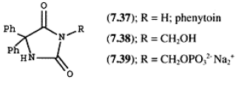
2. Drug solubility:
Anti inflammatory corticosteroids in the form of disodium phosphate or sodium hemisuccinate.
a.
Phosphatases
Phosphate esters of steroidal anti-inflammatory agents
More readily available
ACTIVE DRUG
Esterase
Hemisuccinate salts steroidal anti-inflammatory agents
Less readily Available
b .
Water soluble derivative of phenytoin ,
Metabolized in vivo by phosphatase

Slide 13
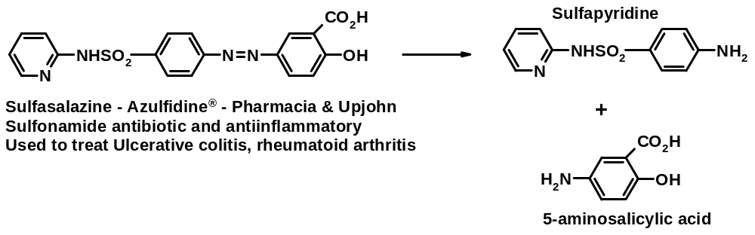
3. Drug stability:
The breakdown on prolonged storage.
To prevent
Rapid degradation on oral administration
a.
b.
Erythromycin estolate (lauryl sulfate salt of propionyl ester)
Colon bacteria
Esterase's
Erythromycin

Slide 14
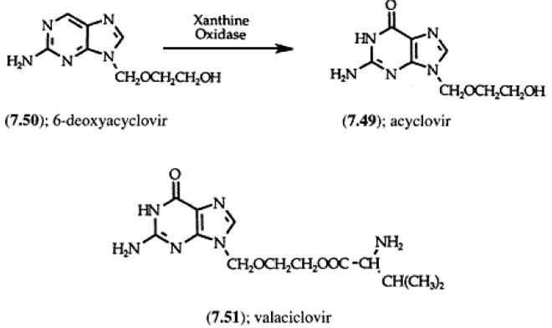
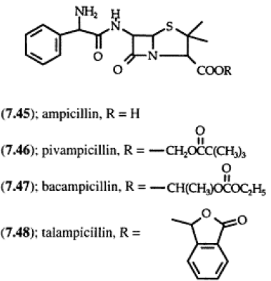
II. Towards pharmacological problems
Drug absorption:
Variation in efficacy between patients, due to unpredictable side drug absorption from G.I.T .
Bioavailability of many drug compounds can be optimized by Prodrug concept.
Examples:
a.
b.

Slide 15
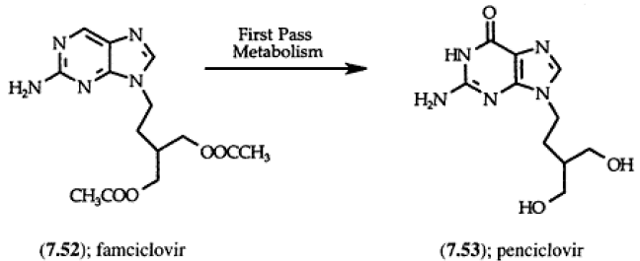
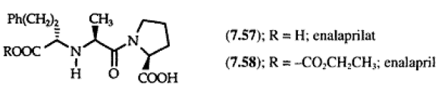
c.
d.

Slide 16
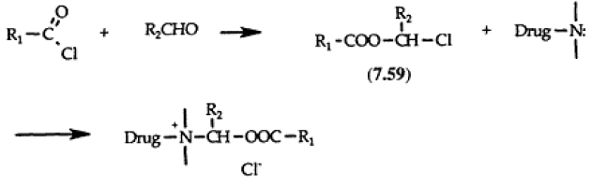
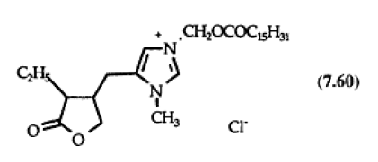

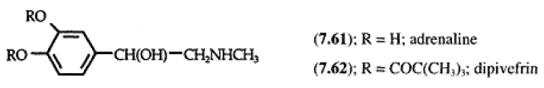
e.
1. Improved bioavailability of pilocapine on ocular administration.
Soft quaternary salts
Mechanism
2. Treatment Glaucoma with Adrenaline.

Slide 17

2. Drug distribution:
The modification of a drug to a pro-drug may lead to enhanced efficacy for the drug by differential distribution of the pro-drug in body tissues before the release of the active form.
Examples:
1. Hetacillin( methoxy methyl ester)
Ampicillin
(More tissue distributed)
2. Cyclophosphamide does not possess alkylating properties and consequently is not a tissue vesicant
Conti..

Slide 18
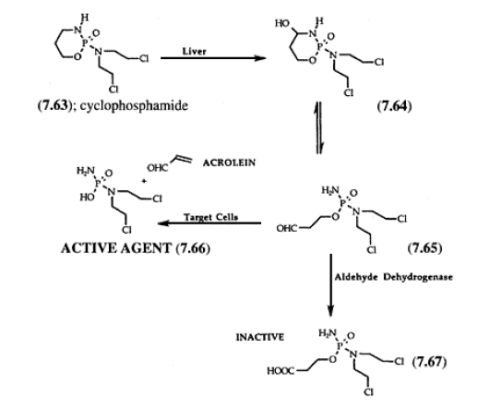

Slide 19
III. Site specific Drug delivery
Pro-drugs have more recently been used to achieve site-specific drug delivery to various tissues.
Such pro-drugs are designed to ensure that the release of the active drug only occurs at its site of action thereby reducing toxic side-effects due to high plasma concentrations of the drug or non-specific uptake by other body tissues.
1. Dihydropyridine—pyridinium salt type redox system :
Nerve gas antagonist pralidoxine into the CNS .
2. Spirothiazolidine derivative of hydrocortisone shows better Anti-inflammatory activity applied Topically and its Systemic effect was decreased after absorption.

Slide 20
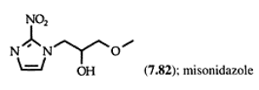
3. Site specific delivery in solid tumors can be achieved by generating hypoxic environment
4. p-nitro substituent of β- chloroethylamine
Normal environment
Hypoxic environment
Formation of alkylating carbonium ion is prevented.
Alkylating species is formed.

Slide 21
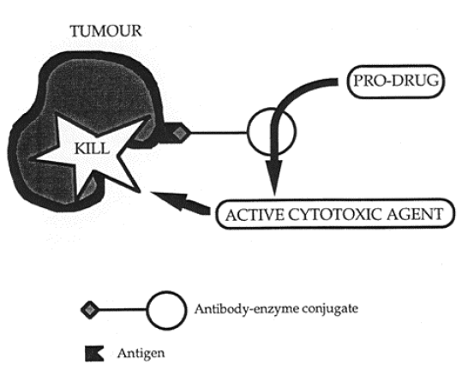
5. ADEPT (Anti body directed enzyme Prodrug therapy) .
Antitumor antibody conjugated to an
enzyme.
The conjugate is localized at
the tumour site via an antibody-antigen
interaction and converts a subsequently
administered pro-drug into a cytotoxic
agent which attacks the tumour.
Taxol ADEPT
β-lactamase enzyme antitumor antibody Conjugate.
pro-drug (PROTAX) = taxol + cepham sulphoxide

Slide 22
Iv. Sustaining Drug Action:
Pro-drug design has also been successfully used to modify the duration of action of the parent drug by either reducing the clearance of the drug or by providing a depot of the parent drug.
Drug | Prodrug | Action
Adrenaline | Bitolterol | Bronchodilator
Phenothiazines | Flupenthioxol | Antipsychotic
Vasopressin | Glypressin | Against Esophageal varicose

Slide 23
Conclusion
Recent advances in biotechnology have made it possible to utilize pro-drug design to develop chemical drug delivery systems which provide various means of targeting the delivery of parent drugs to specific sites within the body.
Clearly, the increasing demands for more efficacious and less toxic drugs will ensure that Prodrug approaches continue to be exploited in the development of future drug substances.

Slide 24
References
Smith and Williams Introduction to the Principles of Drug Design and Action Third edition Edited by H. John Smith Welsh School of Pharmacy University of Wales Cardiff, UK . Amsteldijk 166 1st Floor1079 LH Amsterdam The Netherlands.
Povl Krogsgaard-Larsen, Tommy Liljefors and Ulf Madsen Textbook of Drug Design and
Discovery Third edition First published 2002 by Taylor & Francis 11 New Fetter Lane, London EC4P 4EE.

